Slide 1
Mars Rover Celebration
Teacher Training
Notes:
TRAINER NOTE: The purpose of this presentation is to familiarize teachers with the components of the Mars Rover Celebration curriculum. Be sure that you have actually visited the Mars Rover Website and are familiar with the location of and how to download all of the curriculum components so that you can answer any questions from your participants.

Slide 2
Lesson Overview
The Mars Rover Celebration lesson plans are a unique blend of hands-on science and practical literacy lessons. The students learn what real scientists do and how careers in Science, Math, Engineering, and Technology can be fun and rewarding as they work in a collaborative team to build their Mars rover.
The lessons set the foundation for students’ successful pursuit of STEM careers and demonstrate the importance of language arts skills in STEM fields.
Notes:
The Mars Rover Celebration is a 6 week curriculum that walks teachers and students through an abbreviated simulation of the actual process that NASA scientists follow to create a mission to Mars. Each week has its own theme. The first weeks establish and create background knowledge for students to successfully carry out the research they will need to design their own mission, create their Mars Rover, select and appropriate landing site, build a prototype, and to write a presentation/skit to perform at the culminating event.
Paraphrase the information on this slide.

Slide 3
Science Component
The science component of each lesson walks students through the steps necessary to successfully create their Mars rover mission.
Notes:
Paraphrase the information on this slide.

Slide 4
Language Arts Component
The literacy component of each lesson teaches key vocabulary and provides mini-lessons on research, writing, and presentation skills crucial to student success
Notes:
Paraphrase the information on this slide.

Slide 5
Lesson Sequence
The six week Mars Rover Celebration lesson plans walk students through the process to create a successful mission:
  Week 1: Introduction to Mars Celebration
  Lesson 1: Overview of the Solar System (2 periods)
  Lesson 2: Introduction to the Mars Celebration Project (2 periods)
  Lesson 3: Research Tools and Skills
  Week 2: Investigating Mars
    Lesson 3 (cont.): Research Tools and Skills
    Lesson 4: Investigating Mars (2 periods)
    Lesson 5: Selecting Team Rover Missions (2 periods)
Notes:
Here are the first two weeks’ lessons in detail. Note that several lessons are two periods long. In the first two weeks of the curriculum, students are learning background knowledge that will enable them to carry out their mission. They begin by learning about the solar system, the huge distances that separate the planets from the sun, and the relative sizes of each of the planets.
Armed with this knowledge, students then investigate Mars. They learn about the atmosphere, surface, geology, and climatic conditions on the red planet. This information will prove invaluable as students design their individual missions during week 3.

Slide 6
Lesson Sequence
  Week 3: Designing the Mission
  Lesson 6: Mission Measurements (2 periods)
  Lesson 7: How Do I Measure This? (2 periods)
  Lesson 8: Where is the Best Place to Make These Measurements?
  Week 4: Understanding Rovers
    Lesson 9: Spacecraft Structure and Design (3 periods)
    Lesson 10: Landing, Moving and Surviving Conditions (2 periods)
Notes:
These are the lessons for weeks 3 and 4. In weeks 3 and 4, students refine the focus of their research. During these weeks, students decide on their unique mission to Mars and all subsequent research is geared toward carrying out that mission. Students decide on what they need to measure, the proper instruments to make measurements and where on Mars they can best make those measurements. During week four, students research the design of the spacecraft that will take their rover to Mars and decide on the best method for landing the rover on the Martian surface.

Slide 7
Lesson Sequence
  Week 5: Writing and Building
  Lesson 11: Brainstorm and Preliminary Design (2 periods)
  Lesson 12: Final Design (2 periods)
  Lesson 13: Construct Mock-up (3 periods)
  Week 6: Practicing and Presenting
  Lesson 14: Manual and Skit (2 periods)
    Lesson 15: Present Skits and Models (2 periods)
Notes:
In the final two weeks, students design and build a prototype of their Mars rover. Then, they develop a skit to present at the Mars rover celebration and rehearse their presentation in front of classmates.

Slide 8
Obtaining the Lessons
Two sets of lessons are available:
  Grades 3-5
  Grades 6-8
http://marsrover.phys.uh.edu/LessonPlans.php#LessonPlans
Once on this page, scroll below the outline to find the lesson plans
Update slide with correct info
Notes:
Update this information once the zip files are ready.

Slide 9
Obtaining the Lessons
Each lesson comes in a zip file which will contain the following components:
  Lesson Plan
  Science Notebook
  Vocabulary Cards
  Literacy Mini-lesson (presentation & notes pages)
  Essential Question Card
Notes:
Not every lesson will contain all 5 components and some will contain other items (like Exit Cards). However, the zip file will contain all of the documents required to teach the lesson. There is no longer a need to follow many links to download all of the different resources.
If there are links to videos and other online resources, you can easily access them by opening the electronic version of the lesson plan and clicking the links when prompted to during the lesson.

Slide 10
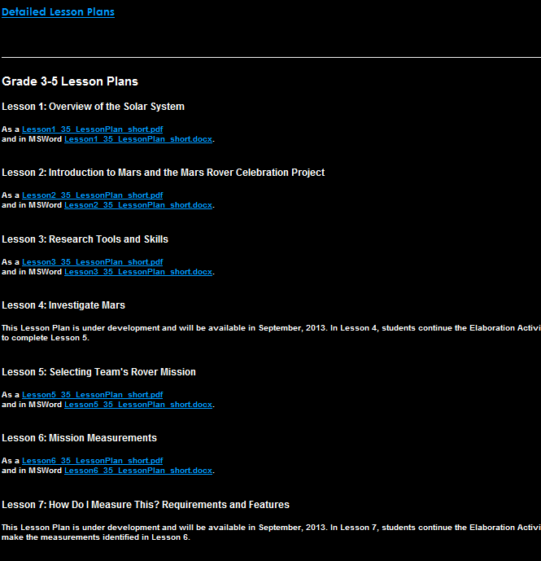
Obtaining the Lessons
Click on the desired lesson either in PDF or Word
Update slide with correct info
Notes:
Replace this slide with the updated information

Slide 11
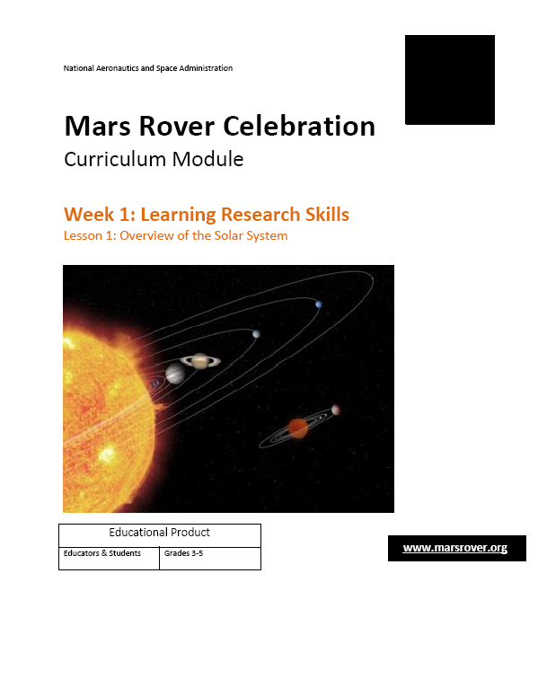
Using the Lesson Plans
Lesson number and name are on title page
Recommended grade level
Notes:
Now that you are familiar with how the curriculum is put together, let’s take a look at the lessons themselves. This slide shows the cover page of the plans. Each lesson has a NASA illustration related to the topic. The lesson number, week and lesson title all appear in orange above the illustration (point to this). The recommended grade level of the lesson appears in a box below the illustration.

Slide 12
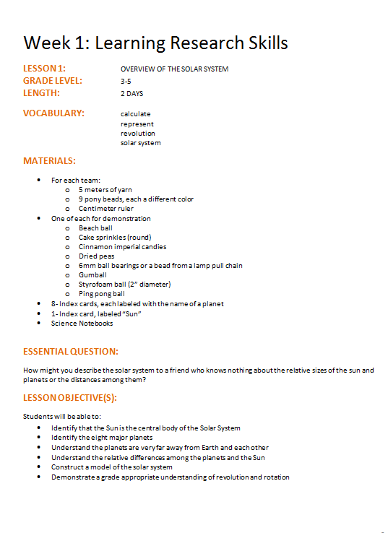
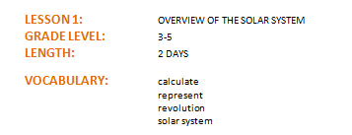
Features of the Lesson Plans
Each lesson indicates the grade level and expected length
The Key Vocabulary for Students section lists the critical vocabulary used in the lesson. The vocabulary cards for each lesson match the words on this list.
Notes:
This slide has 1 CLICK of animation.
Several vocabulary resources are provided for you in the lesson plans. CLICK
At the very top of each lesson, you will find the lesson name, the grade level and the expected length. You can refer to the pacing guide for more specific indications on how long each part of the lesson is expected to take.
The next section lists the KEY vocabulary for the lesson. The words selected for the key vocabulary were carefully chosen based on two criteria. The words are either key science terms essential to an understanding of the lesson being taught or they are high frequency, high utility, academic words that students will encounter with regularity in their studies. CLICK On the examples shown here, revolution and solar system are key to the lesson while the other two words (calculate and represent) are of a more general nature. The key vocabulary are the same words on the vocabulary cards provided in the zip file for the teacher to review in the Engagement section.

Slide 13

Features of the Lesson Plans
Material lists make lesson preparation easy
Each lesson has an Essential Question (EQ) which is posed to students at the onset. The EQ sets a purpose for learning and generally cannot be answered until the entire lesson is completed. Teachers return to the EQ at the close of each lesson to check student understanding
Notes:
This slide has 1 CLICK of animation.
Paraphrase the information on this slide and CLICK at some point during your explanation. Then say:
The essential question (called an EQ) for each lesson should be printed out and posted in a prominent place in the classroom. Not only does the question serve to focus the students’ attention on the learning they are expected to gain during the lesson, but it also serves as a convenient reminder for you to return to the EQ at the end of the lesson. By posing the EQ to your students as you close the lesson, you can quickly gauge how well they understood the information in the lesson and what may need to be retaught.

Slide 14
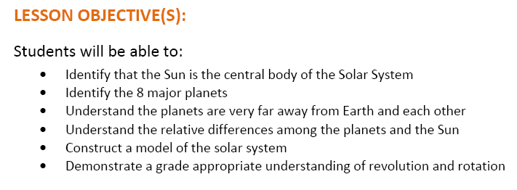
Features of the Lesson Plan
Lesson objectives allow teachers to document skills taught in each lesson
Notes:
This slide has 1 CLICK of animation.
Paraphrase the information on this slide. Then say, let’s take a closer look at the objectives for this particular lesson.
CLICK (Review the objectives as you see fit with participants)

Slide 15
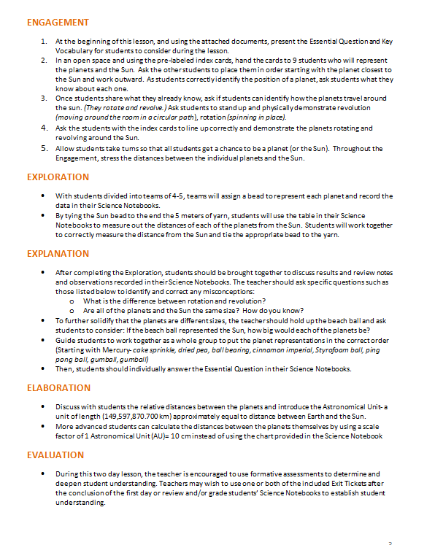
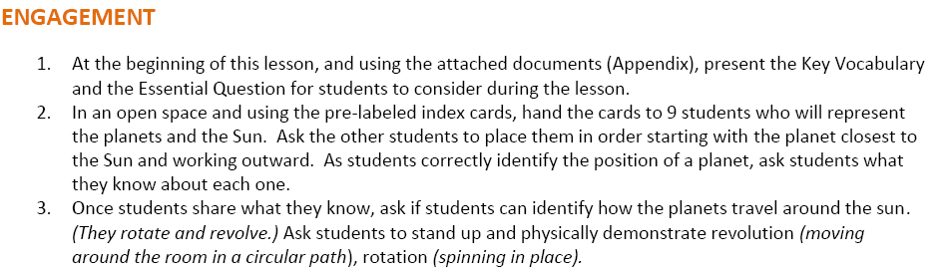
Features of the Lesson Plan
The Engagement section sets the stage for learning by piquing student interest. Students learn key vocabulary and crucial background knowledge through the use of engaging, interactive activities
Notes:
This slide has 1 CLICK of animation.
The engagement section of the lesson is designed to get your students interested in and excited about the material in the lesson. Lets take a closer look at the steps for this section of the lesson.
CLICK
Teachers start by introducing the Essential Question and the key vocabulary for the lesson in step 1 of the engagement. The vocabulary cards have a suggested text and I will be showing these to you in more detail a little later.
After introducing the EQ and the vocabulary, students engage in a hands on activity in the following steps (Walk participants through the activities shown here in steps 2 and 3)

Slide 16
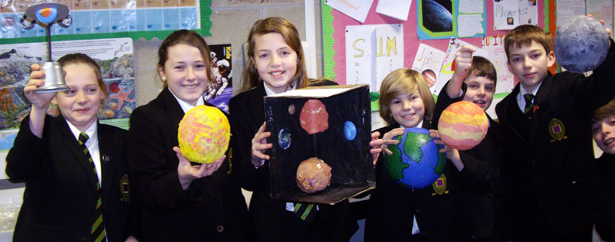
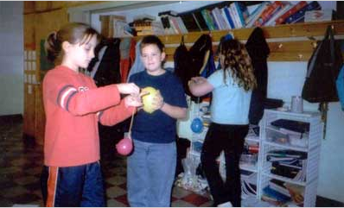
Features of the Lesson Plan
Notes:
This slide shows what the engagement part of the lesson might look like in a classroom.

Slide 17
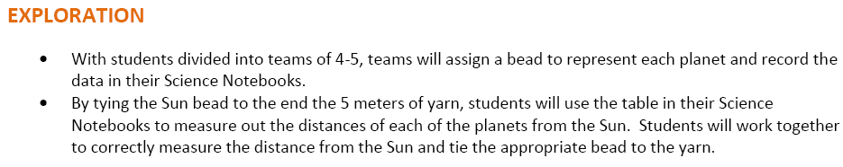
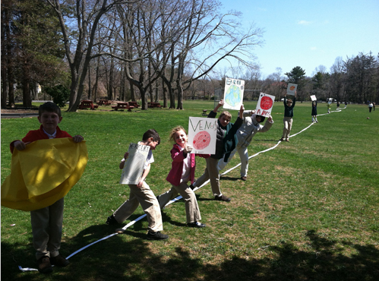
Features of the Lesson Plan
The Exploration section helps students learn critical information through hands-on, active learning, not passive seatwork
Notes:
This slide has 1 CLICK of animation.
The Exploration section is the discovery-inquiry piece of the lesson where students are actively engaged in learning. The exploration section of each lesson is carefully crafted so that students learn key information by doing. Let’s take a look at how this is done in our sample lesson. CLICK.
(Go over the activity with your participants. Note that the illustration shown here is a variation on the yarn activity where the beads have been replaced with students and the activity has been moved outdoors to demonstrate the relative distances between the sun and planets.

Slide 18
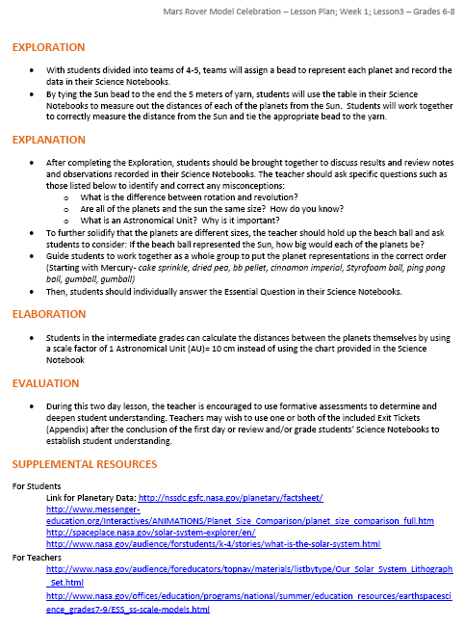
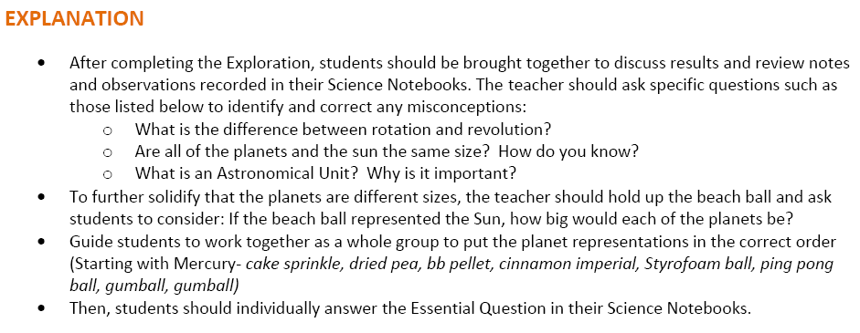
Features of the Lesson Plan
The Explanation section allows students to synthesize and integrate their learning. The teacher monitors and reteaches to ensure student understanding. Science notebooks document the learning taking place.
Notes:
This slide has 1 CLICK of animation.
Paraphrase the information on this slide. Then CLICK and review the Explanation section of this lesson with your participants.

Slide 19

Features of the Lesson Plan
The Elaboration section offers suggestions on differentiating instruction for groups of all ability levels. It also offers ideas for additional activities should time permit.
Notes:
This slide has 1 CLICK of animation.
If time permits, each lesson contains an elaboration section with additional activities to further student understanding and offers suggestions on differentiating instruction for groups of all ability levels.
(CLICK and review the elaboration for this lesson with your participants.)

Slide 20

Features of the Lesson Plan
The Evaluation section offers teachers suggestions for assessing student progress and for obtaining grades for the work completed.
Notes:
This slide has 1 CLICK of animation.
Paraphrase the information on this slide, then CLICK and review the evaluation shown here.

Slide 21
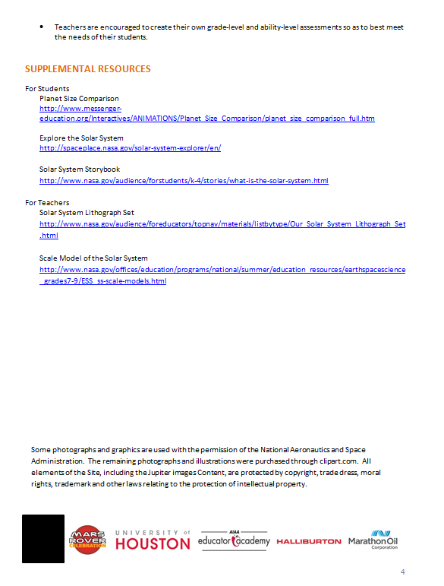
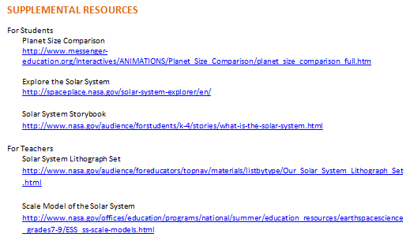
Features of the Lesson Plan
The Supplemental Resources section provides links to online resources with additional information for students and teachers.
Notes:
This slide has 1 CLICK of animation.
Paraphrase the information on this slide, then CLICK to bring up the links. The student section is first, followed by the teacher section. Each link has an individual title with the a brief explanation of the content. This will allow you to determine at a glance which links might be of most utility or interest for you and your students.

Slide 22
Before Each Lesson…
Preview all lesson plan components that involve your classroom computer:
Make certain that all video links work
Check mini-lesson PowerPoint presentations
Check Google Earth Mars and Gale Crater Interactive (Lessons 3 and 8)
Notes:
We strongly recommend that you double-check all of aspects of each lesson that involve your classroom computer before beginning your lesson so that you can troubleshoot any problems beforehand.
With the Power Points, check both that the mini-lessons will load and that the animation is working properly.

Slide 23
Materials in the Zip Files
Notes:
Now, let’s take a look at the support materials for each lesson provided for you in the zip files.

Slide 24
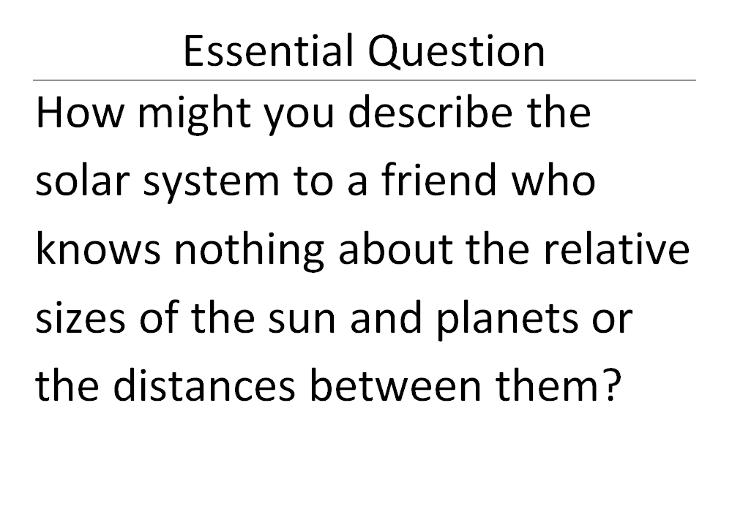
Essential Question Card
Each lesson has a link to the Essential Question which may be printed out on an 8 ½ by 11 sheet and posted in a prominent place in the classroom.
Posting the EQ is recommended as it serves as a visible reminder for students about what they are expected to learn in each lesson.
Notes:
Paraphrase the information on this slide.

Slide 25
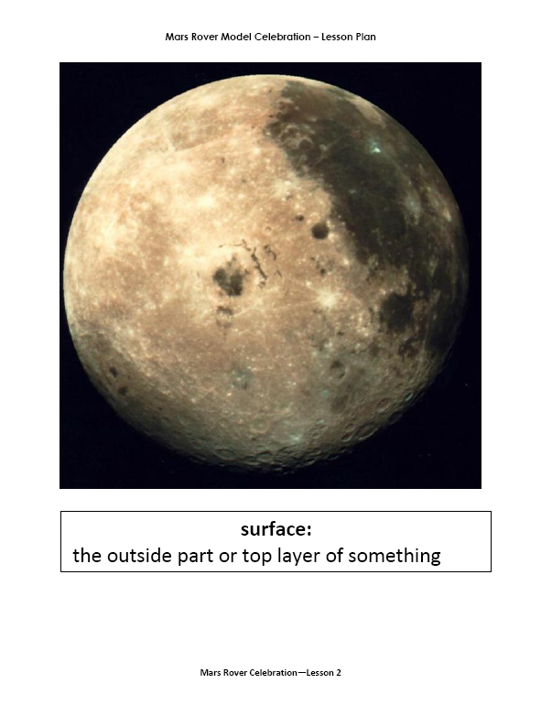
Vocabulary Cards
Carefully chosen illustrations clarify word meanings and form part of the explanation of the word
Student friendly definitions assist students to understand and learn critical vocabulary words
Notes:
The vocabulary cards use effective, research-proven methods to help students learn and remember key vocabulary. Shown here is the front of a typical card. Carefully chosen illustrations (like the one shown here) help to clarify word meanings and form part of the explanation of each word. Underneath the illustration (or illustrations) is a student-friendly definition. Rather than using often confusing, dry and complex “dictionary definitions”, the definitions included on the card are carefully crafted so that they are easily understood by your students, even those who may be English Language Learners.
For example, typical dictionary definitions of SURFACE are, “the exterior or upper boundary of an object or body” and “a two-dimensional, topological manifold”. Definitions such as these do not help young students learn new vocabulary because the words used in the definitions are often unfamiliar and more complex than the target word. Compare the definitions I just shared with you to the one used on the card for surface, ‘the outside part of top layer of something”.

Slide 26
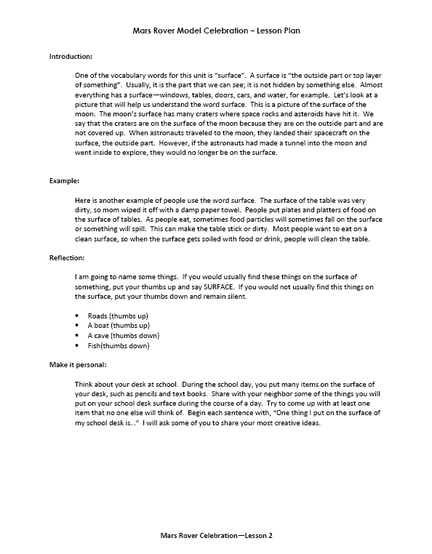
Vocabulary Cards
New vocabulary is taught using scientifically proven methods…
Student friendly definitions
Examples and Non-examples
Multiple exposures to the target word in different contexts
Word origins and cognates are taught when applicable
Actively thinking about the word in real contexts
Using the word in real-life, practical and personally relevant situations
Notes:
This slide has 5 CLICKS of animation.
The back side of the vocabulary card has suggested language for helping students to learn the key vocabulary. It starts by restating the student friendly definition CLICK.
Each card provides students with examples (and non-examples when appropriate) of proper use of the word in various contexts. CLICK
Each card provides students with multiple exposures to the vocabulary term in a variety of contexts. Reading research indicates that most students need to hear a new word 12-15 times for it to become part of their working vocabulary. CLICK
When words have close cognates (words that are written and/or pronounced similarly in two languages) in Spanish, these are pointed out to students. This can be particularly helpful to Spanish-speaking students in your class who may already know a very similar word in Spanish. In these cases, students only need to put the English label onto a known word/concept in Spanish, simplifying the task of learning new vocabulary. In other cases, students are taught how they can use word origins and other morphological elements of language (root words, prefixes and suffices) to teach students how they can learn new vocabulary on their own using these same strategies.
The reflection section of each card requires students to actively think about and interact with each targeted word. CLICK. Usually students are asked to listen to brief phrases or sentences and determine whether or not the target vocabulary word goes with that sentence. In the example shown here, students are asked to put their thumbs up and say the word SURFACE if the if the items the teacher says can be found on the surface (walk your participants through this section).
Finally, students are asked to use the target word in real-life, practical, and personally relevant situations in the “Make it Personal” section of each card. On the example for surface shown her, the teacher says the following to students, “Think about your desk at school. During the school day, you put many items on the surface of your desk, such as pencils and text books. Share with your neighbor some of the things you will put on desk during the course of a day. Try to come up with at least one item that no one else will think of. Begin each statement with, “One thing I will put on the surface of my school desk is…” I will ask some of you to share your most creative ideas.

Slide 27
Literacy Mini-Lessons
Most lessons contain literacy mini-lessons which provide short lessons on essential language arts skills related to their Mars rover project. Topics include…
Internal Dialogues
Informational Text Features
Note Taking
Writing a Scientific Question
Making Inferences & Predictions
Learning New Vocabulary
Making Concept Maps
Writing Effective Captions & Labels
Writing a Presentation
Notes:
Paraphrase the information on this slide.

Slide 28
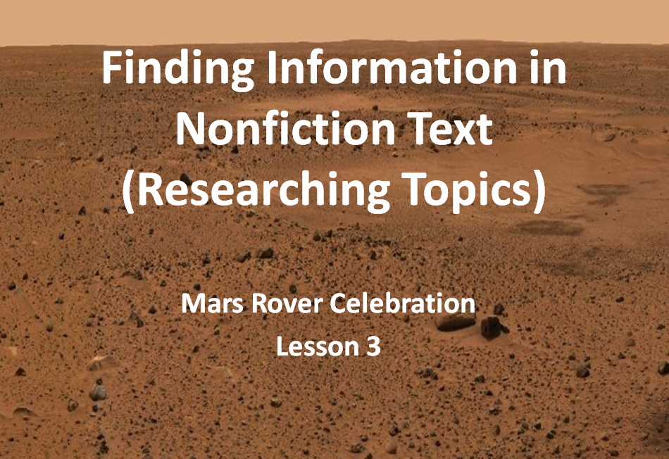
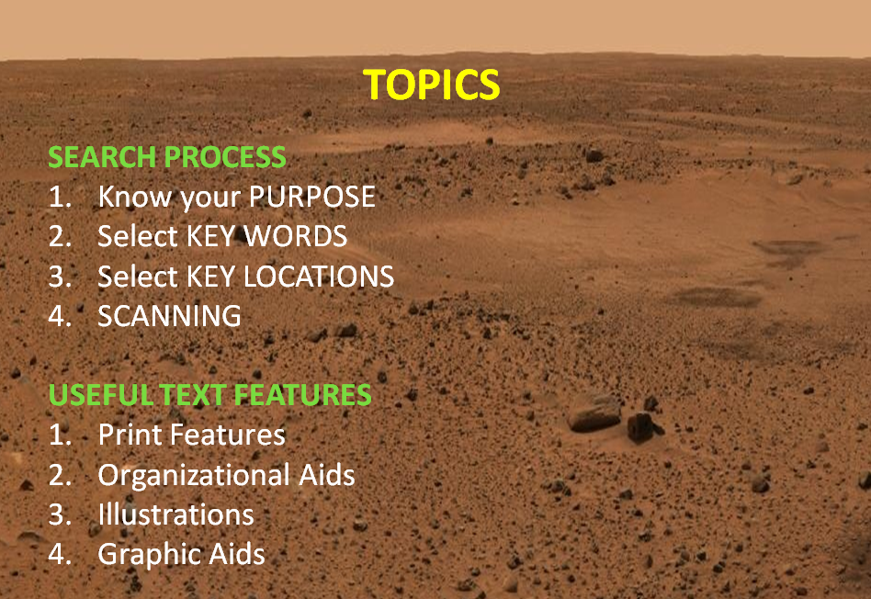
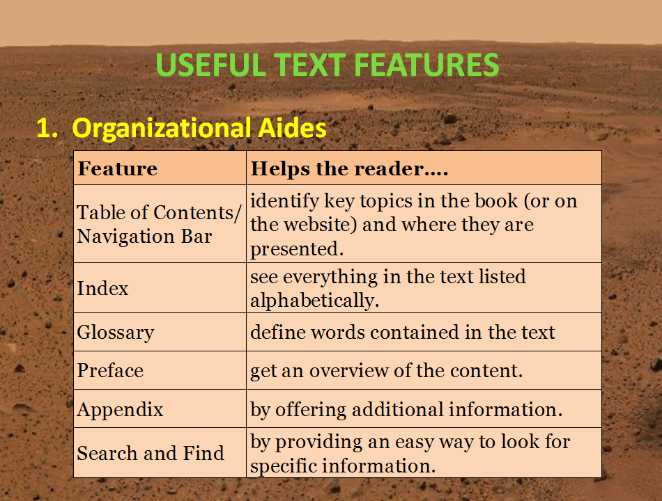
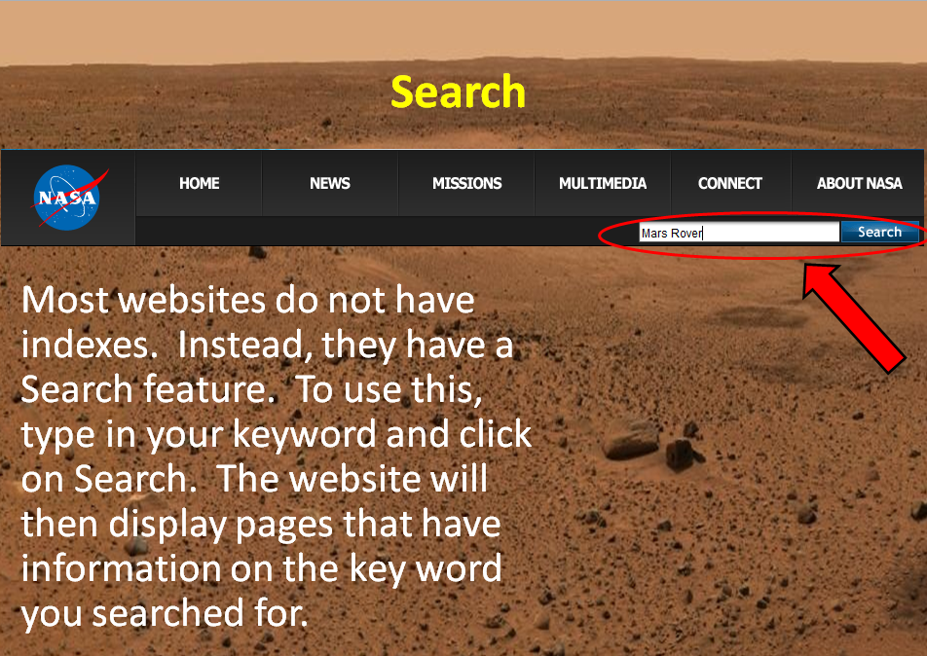
Literacy Mini-Lessons
Notes:
This slide has 3 CLICKS of animation.
An example of one of the mini-lessons is shown here. Research skills are a must for STEM careers. Students in the Mars Rover Celebration research may aspects of their mission. To teach students how to find information in both print and electronic sources, one of the mini-lessons developed is titled “Finding Information in Non-fiction Text”. This mini-lesson walks students through many of the features found in print and electronic text so that they are able to quickly and effectively find the information they need. Here are a few of the slides from this mini-lesson.
CLICK—This lists the topics covered in the mini-lesson. (Allow your participants a moment to read these)
CLICK—Aids to research for both print –CLICK– and electronic sources are shown.

Slide 29
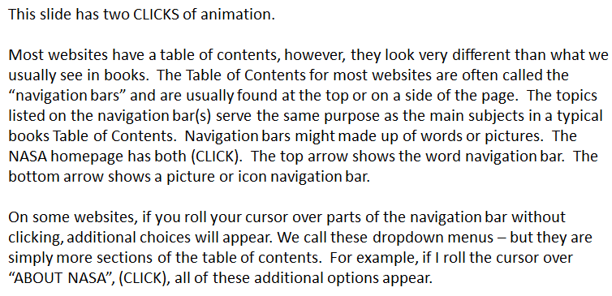
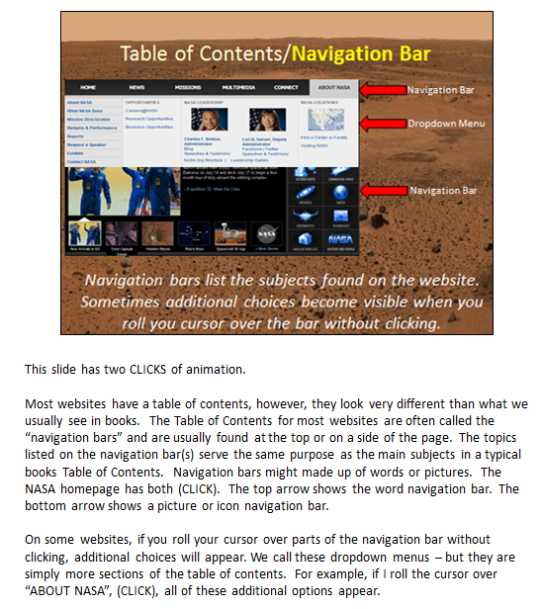
Literacy Mini-Lessons
The mini-lessons include notes which can be viewed in the Notes Page view. These notes indicate when there is animation on the slide and give suggested verbiage for discussing the content which you can use as is or modify to suit your teaching needs.
Notes:
This slide has 2 CLICKS of animation.
When a lesson contains a literacy mini-lesson, it is included in your zip file in 2 formats. One is the power point presentation for you to present to your students, shown on the previous slide. In addition, there is a PDF of the presentation in a note pages view which you can print out to use to teach each mini-lesson. Let’s take a closer look at the notes. CLICK
As mentioned earlier, whenever a slide has animation, the notes begin with a sentence that tells you how many CLICKS are required on the slide. The rest of the page has suggested language on how to discuss the information on the slide. Depending on the ability level and background knowledge of your group, you can either read the slides as is or modify them to suit the needs of the class.

Slide 30
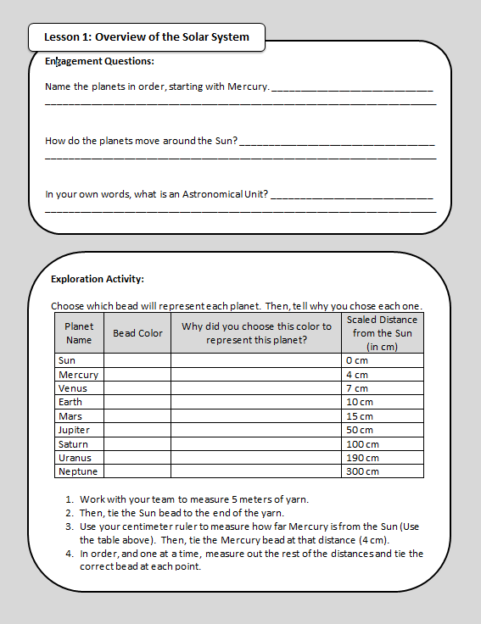
Science Notebooks
The Science Notebooks contain written questions and activities related to each lesson.
Notes:
The Mars Rover curriculum also contains a comprehensive Science Notebook. The notebook contains activities that reinforce the lesson objectives and give your students a single place to record their research. The notes and other information in the Science Notebooks can then be used to write the actual Mars Rover mission and the skit.
The entire Science notebook is in the Master Overview File, making reproducing the notebook for your students easy. If you prefer, the part of the notebook relevant for each lesson is found inside that lesson’s zip file.

Slide 31
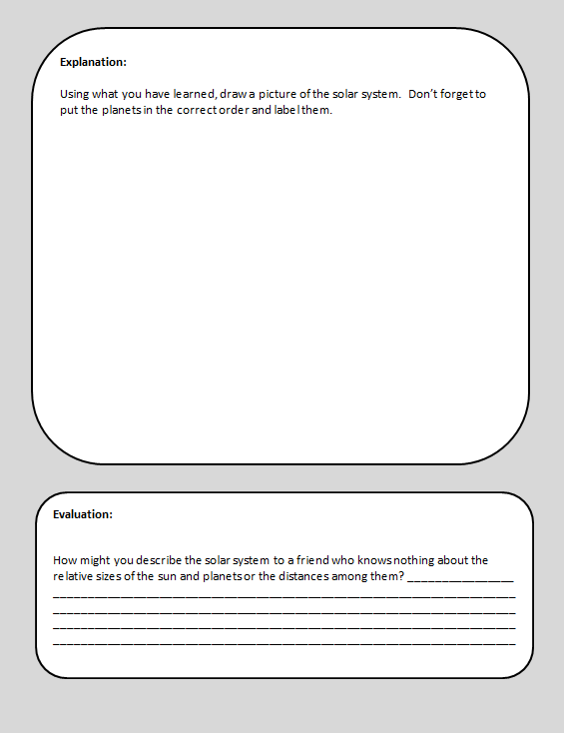
Science Notebooks
The Science Notebooks often allow for alternate assessment of student comprehension through the uses of drawings, etc…
The notebook also has a space for the students to draft a written response to the Essential Question
Notes:
Beyond note-taking and helping students organize and record their learning, parts of the notebooks can be used to assess student learning, as on the page shown on this slide.

Slide 32
Common Files Materials
Notes:
The Common Files are contain the materials you will use throughout the Mars Rover Celebration curriculum. They include:
The Mars Rover Celebration Topics List (lesson listing)
The Pacing Guide
Instructions for Downloading Google Earth
Student-friendly Glossary
Teacher Glossary
A full set of reproducible Poster size (8 ½ by 11) Essential Questions
A complete Science Notebook
Strand Map Resources
A Formative Assessment Strategies Document
Mars Rover Achievement Patches Template
Let’s look at each of these.

Slide 33
Insert Screen shot of common files section of lesson plan page

Slide 34
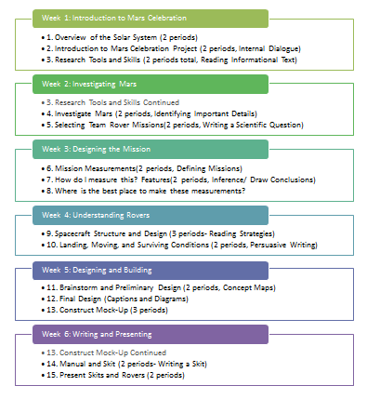
Topics List
Notes:
This is the Topic list file, which provides a listing of the 15 different lessons covered in Mars Rover. Another document in the common file is the Pacing Guide which provides more detail on how much time should be spent on each part of each lesson. Let’s take a look at the Pacing Guide.

Slide 35
Pacing Guide
The Mars Rover Celebration Pacing Guide can help you stay on track as you teach the curriculum. The Pacing Guide outlines how many days each lesson is expected to take and makes recommendations on how much time to spend on the individual components of each lesson.
For each lesson, the Pacing Guide also lists the essential question, the activities available and the key vocabulary words.
Notes:
Paraphrase the information on this slide. Then say,
Let’s take a look at part of the pacing guide.

Slide 36
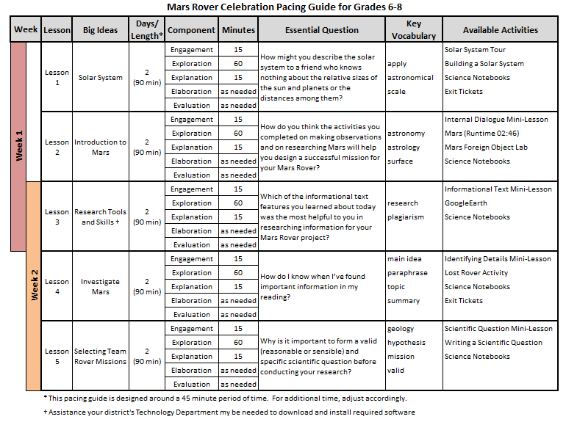
Pacing Guide
Notes:
This slide has 5 CLICKS of animation.
Shown here is part of the Mars Rover Celebration Pacing Guide for grades 6-8. The grades 3-5 pacing guide looks very similar. Let’s take a closer look at the features that will help you stay on track with the curriculum.
CLICK--First, each week’s lesson is color-coded. If a particular lesson bridges two weeks, the colored bars overlap (Point to the blue circle).
CLICK—Next to the lesson number and theme, there is a column that indicates the length of each lesson. Most lessons are designed to take two or three days, not a single class period. The total time for the lesson is also listed. When designing the lesson plans, a 45 minute class period was the assumption. If you have a different period of time for Mars Rover, adjust your pacing accordingly.
CLICK—The major components of each lesson (Engagement, Exploration, Explanation, Elaboration and Evaluation) are listed in the following column as well as the recommended time for the first three. No time recommendations are made for Elaboration as student needs and time constraints will determine how often a teacher covers this section. Nor is a time recommendation made for the evaluation, which can be as simple or elaborate as desired.
CLICK—The next two questions have the essential question and the key vocabulary for each lesson. This allows the teacher to quickly locate the needed files/documents and have them ready to teach the lesson.
CLICK—The final column lists the major activities for each lesson.

Slide 37
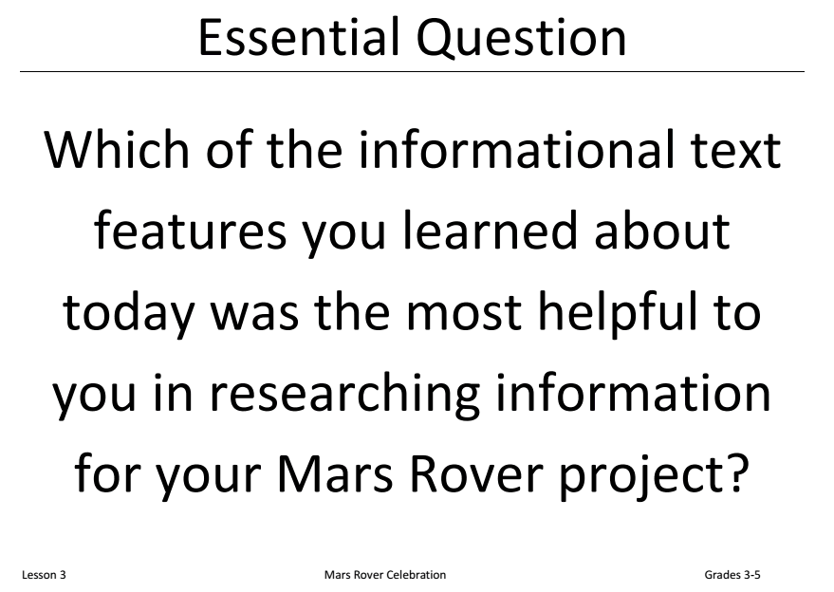
Essential Questions Cards
Notes:
Another resource in the common file is a single document with all 15 Essential Questions (one for each lesson of the curriculum). This would be particularly helpful if you would like to print all of the questions out at one time, in a larger size or on special paper—rather than having to pull these out of the individual lessons.

Slide 38
Science Notebooks
The common file contains a single PDF document with the Science Notebooks for all 15 lessons.
Notes:
The common file contains a single PDF document with the Science Notebooks for all 15 lessons. That way, if you want to print the entire notebook at once, it is easy to do.

Slide 39
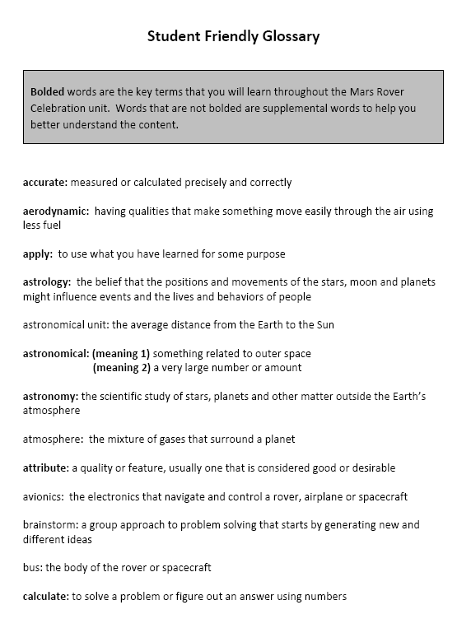
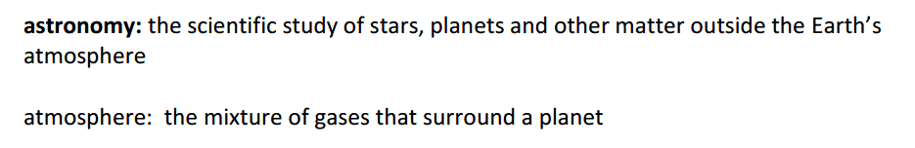
Student-Friendly Glossary
Notes:
This slide has 1 CLICK of animation.
Also included in the zip file is a student-friendly glossary. This glossary contains all the key vocabulary words from each lesson as well as additional terms for which students may need definitions. The key terms are BOLDED while the additional words are in regular font.
CLICK (Point out the two words.)

Slide 40
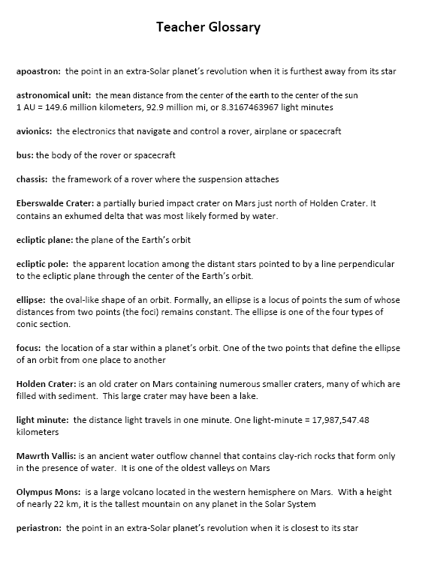
Teacher Glossary
Notes:
There is also a teacher glossary. The teacher glossary mostly contains terms that are not used in the lessons but that teachers may wish to use with more advanced students.
(You may go over the list at your discretion.)

Slide 41
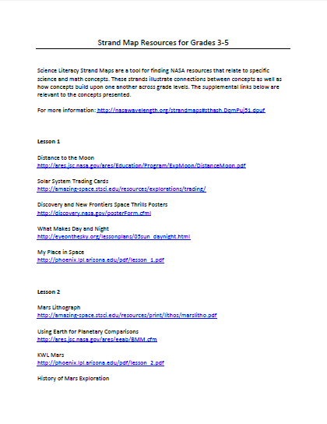
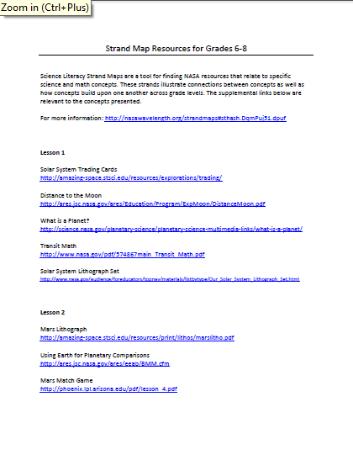
Strand Map Resources
Notes:
Science Literacy Strand Maps are a tool for finding NASA resources that relate to specific science and math concepts. These strands illustrate connections between concepts as well as how concepts build upon one another across grade levels. The supplemental links listed in the “Strand Map Resources” are relevant to each of the lessons under which they are listed.

Slide 42
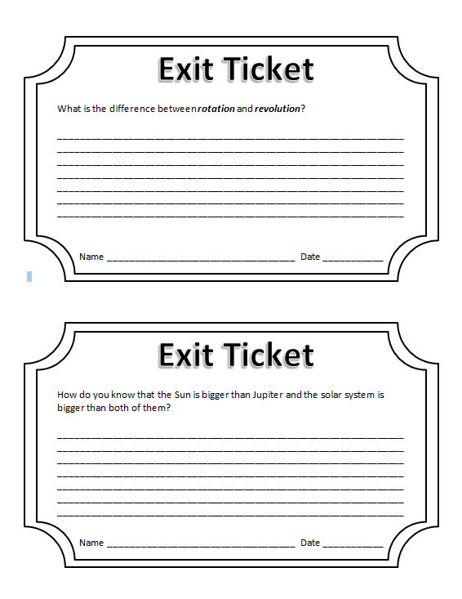
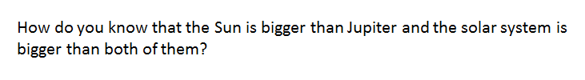
Exit Tickets
Exit Tickets allow students to apply the knowledge they have acquired by answering higher-level questions related to the lesson. There is one Exit Ticket for each of the six weeks.
Notes:
Paraphrase the information on this slide.

Slide 43
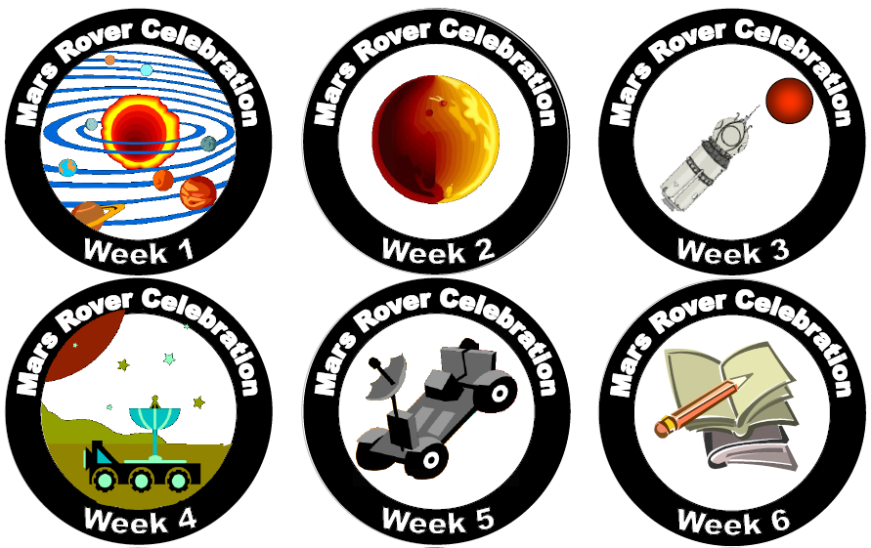
Mission Patches
Mission Patches allow students to feel like real astronauts. Teachers may print out the templates (on labels) and give these to students each week upon the successful completion of that part of the mission. It is a great way to keep students excited and motivated.
Notes:
To promote a sense of accomplishment, kids can earn "patches" for completing each week of the Mars Rover Celebration. These "patches" can be printed on Avery labels #5294 which are pretty easily found. Stickers end up being about 2" in diameter. Teachers are invited to find creative ways for their students to show off their “Mars Rover Mission Patches”.

Slide 44
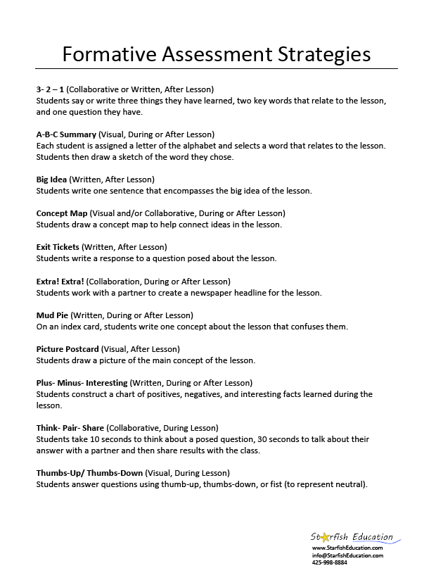
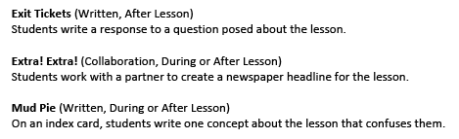
Formative Assessment Strategies
Notes:
This slide has 1 CLICK of animation.
The common file also contains a Formative Assessment Strategies sheet. This is a listing of creative ways teachers can assess student during or after a lesson. Let’s take a closer look at some of these. CLICK
(You may discuss this with participants at your discretion.)

Slide 45
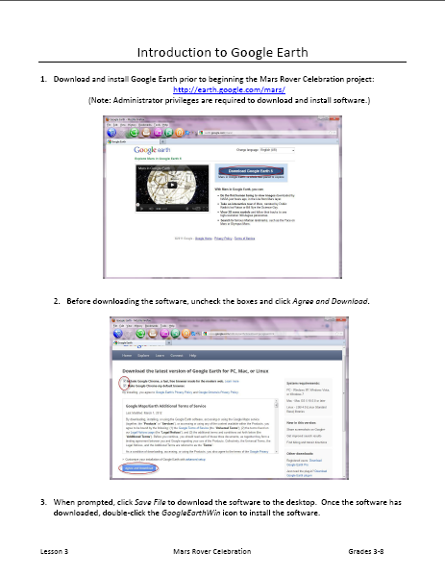
Installation Instructions
The Mars Rover Celebration lesson plans also contain a set of easy-to-follow directions to download Google Earth Mars on your computer.
Notes:
If you are installing Google Earth Mars by yourself, a step-by-step guide is available in the Master Overview zip file.

Slide 46
Before You Get Started
Notes:
There are several things we recommend you do before you begin the curriculum to avoid having technical difficulties during your lessons.

Slide 47
Install or ask your IT person to install…
The latest versions of Flash, Java, and Shockwave.
Google Earth Mars
The software to run the Gale Crater Interactive
Microsoft Silverlight 4 (required for Worldwide Telescope)
Notes:
The software listed on this slide are used by the videos and applications recommended throughout the curriculum.
If you have the necessary permissions on your classroom computer, ensure that the software listed on this slide are installed and/or updated.
If you do not have administrator privileges on your computer, contact your IT person to install and check these. We recommend having all installed at one time.

Slide 48

Questions

